Slide 1
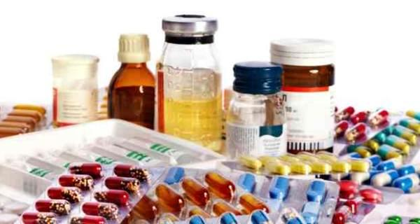
Surplus Medicine Distribution System

Slide 2
INTRODUCTION
1

Slide 3
Objective of this project is to link and develop a flow mechanism in a system that aims at providing medicinal drugs to patients who cannot pay for it and gives users a chance to appropriately discard their unused meds while doing some good for the society.

Slide 4
PROBLEM STATEMENT
2

Slide 5
Why do we need this system?
We discard remainder of medicines after completion of prescribed course.
Meanwhile there are people who cannot afford these drugs due to financial crisis.
These people could actually use these spare/surplus medicines.
Hence, the problem is the lack of flow of these medicinal drugs which could satisfy the supply and demand for the same

Slide 6
Solution
How do we overcome this problem?

Slide 7
We propose the following system
Our solution consist of three main entities, the users, the NGO inventory management organization and the healthcare organization. The users can register with the NGO organization the medicines which they wish to give along with few vital details about the meds. The NGO inventory management organization will verify and add these drugs to their inventory. Medicines in the inventory will be of two types: prescribed medicines and off the shelf medicines. Hospitals can request medicines from NGO inventory management organization for patients who cannot afford it. The users can also view inventory catalogue and request medicines but only off the shelf medicines. The system further provides the facility of sending the expired medicines to an entity which ensures proper disposal of drugs. Thus avoiding wastage and supporting the society healthcare.

Slide 8
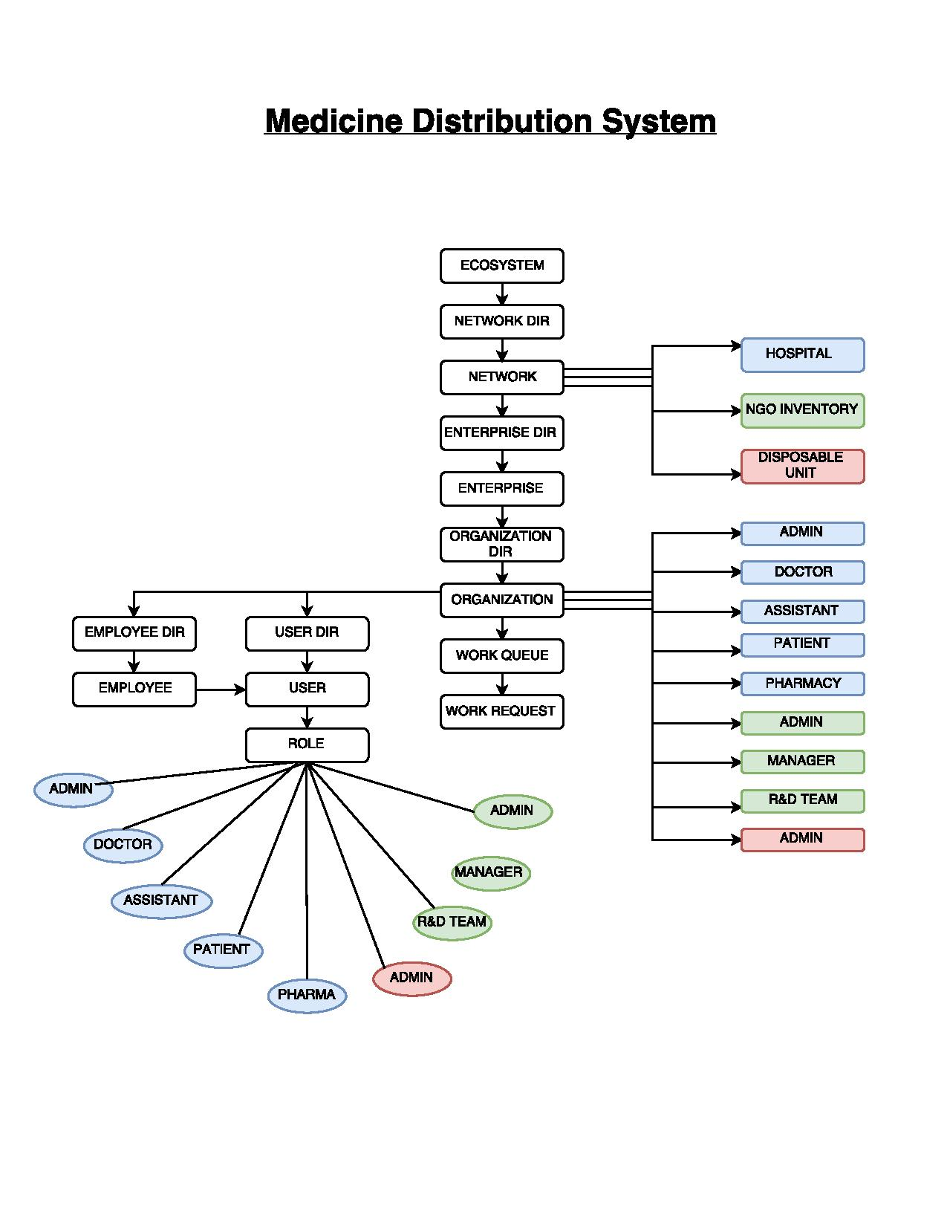
Object Model

Slide 9
Test Cases
Person can donate medicines or order medicine from NGO inventory. Person can also schedule and appointment for checkup.
NGO can approve or reject a donation request based on his verification of medicine with help of R&D team.
Doctor can process a patient and prescribe medication.
Disposable unit manages disposal of medicine drugs from hospital, person and NGO.

Slide 10
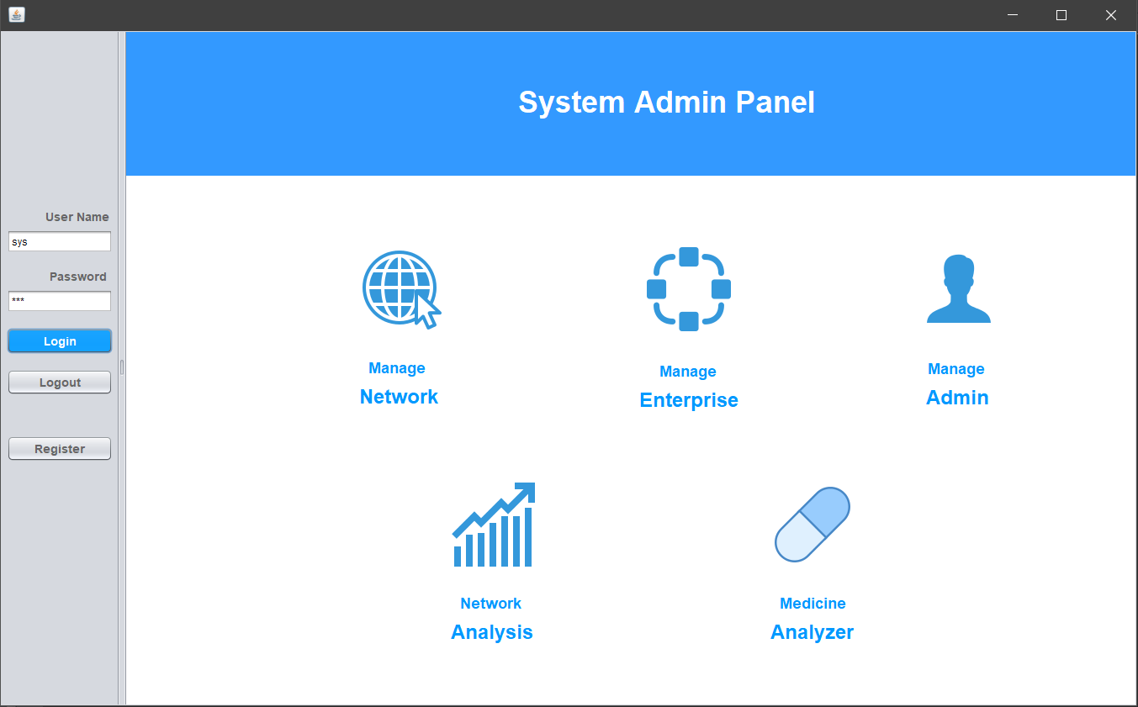

Slide 11
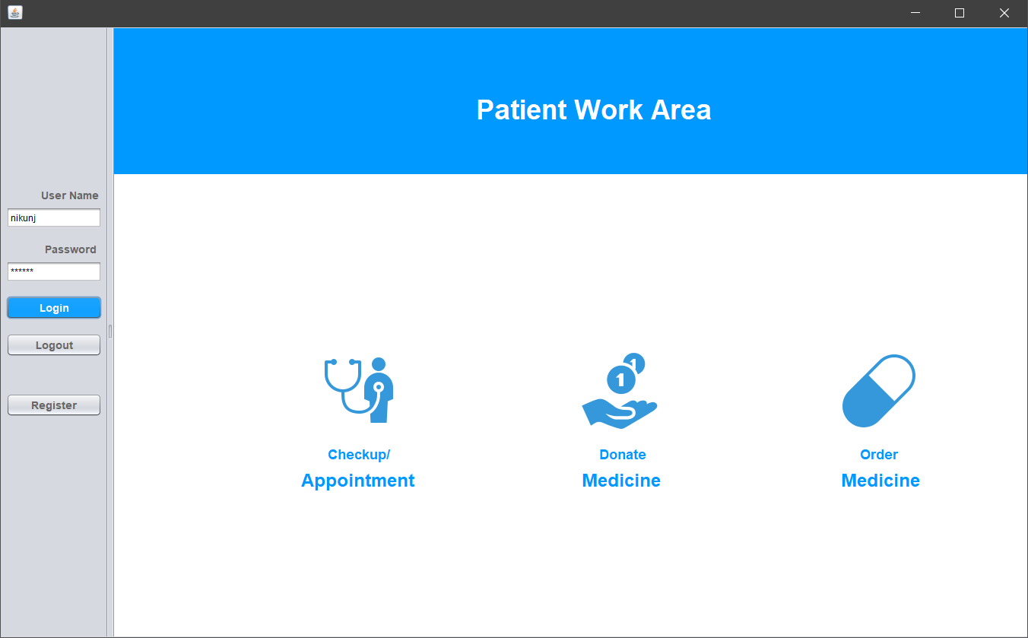

Slide 12
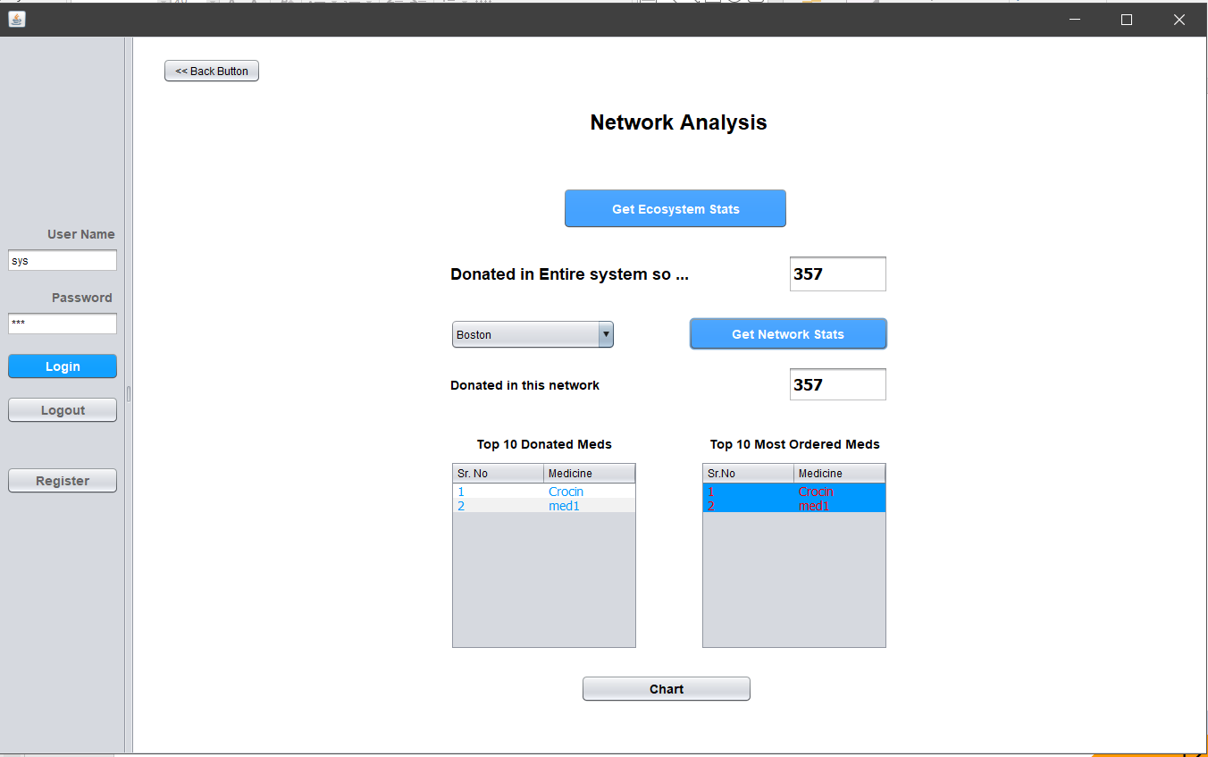

Slide 13
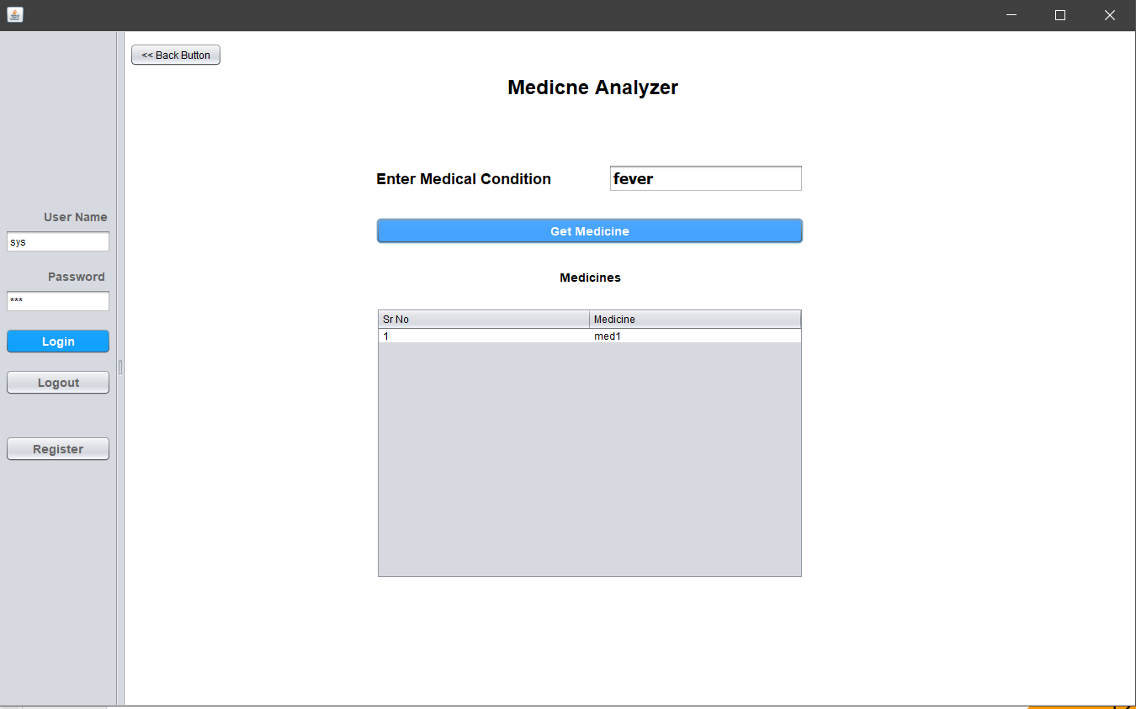

Slide 14
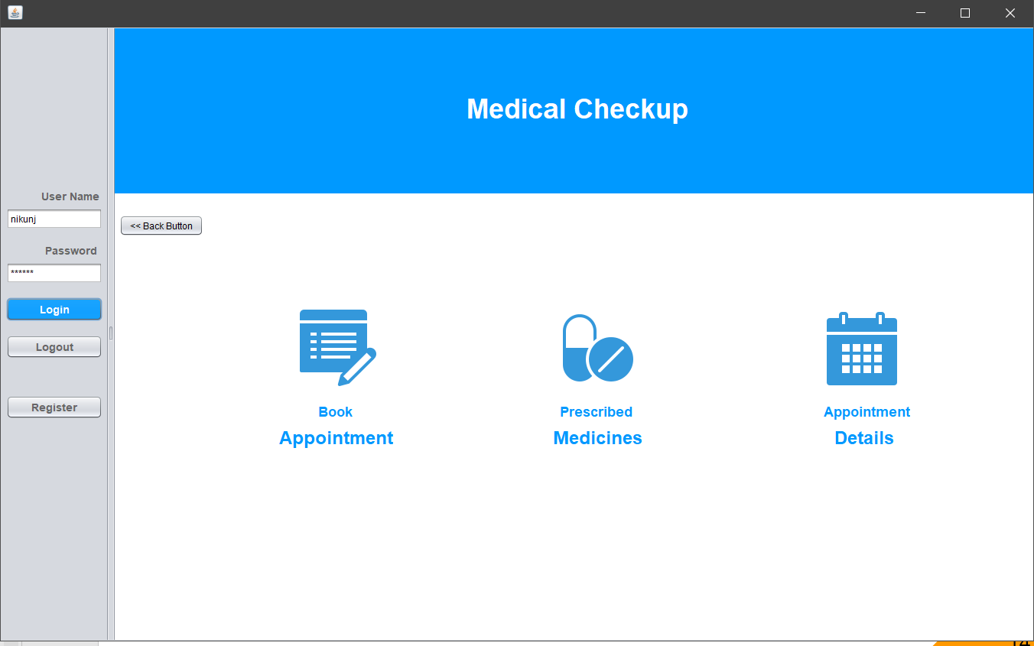

Slide 15
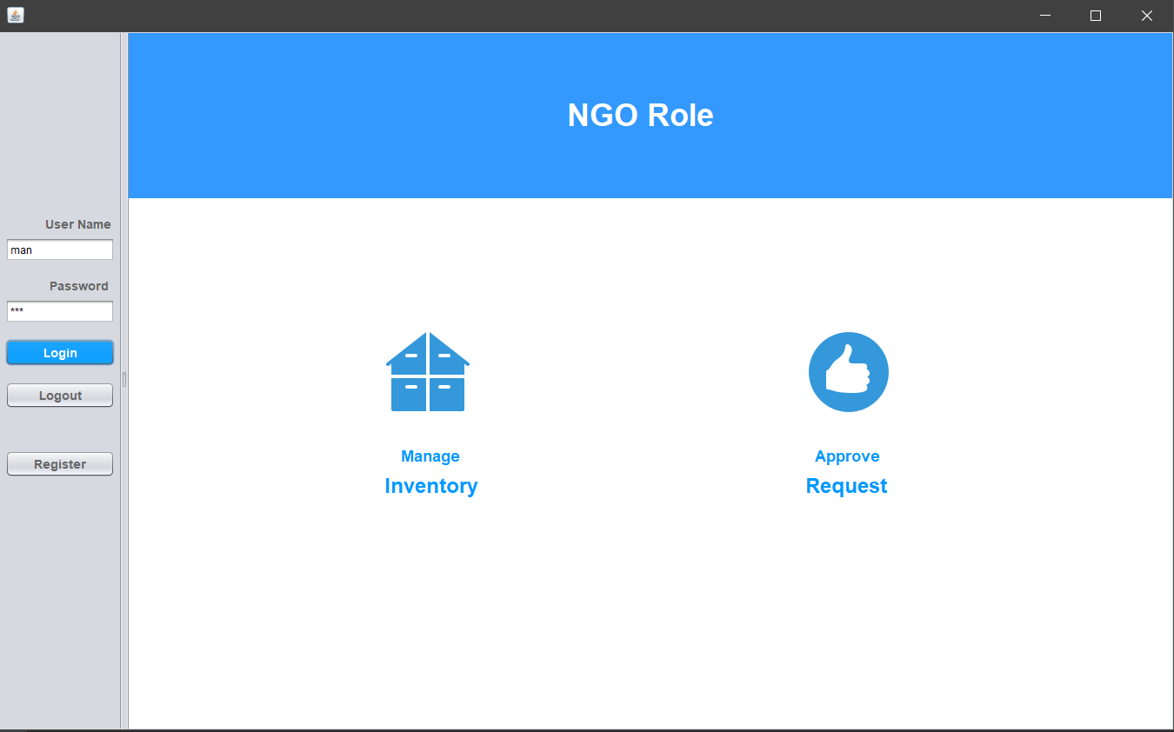

Slide 16
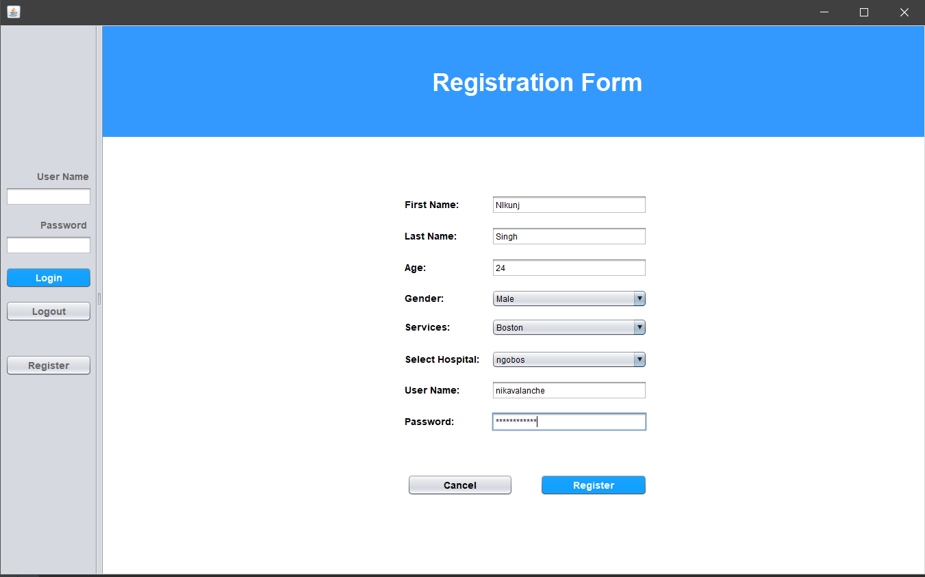

Slide 17
THANKS!
Any questions?

